Slide 1
Unit 5-1
Isosceles and Equilateral Triangles
PLANE Geometry

Slide 2

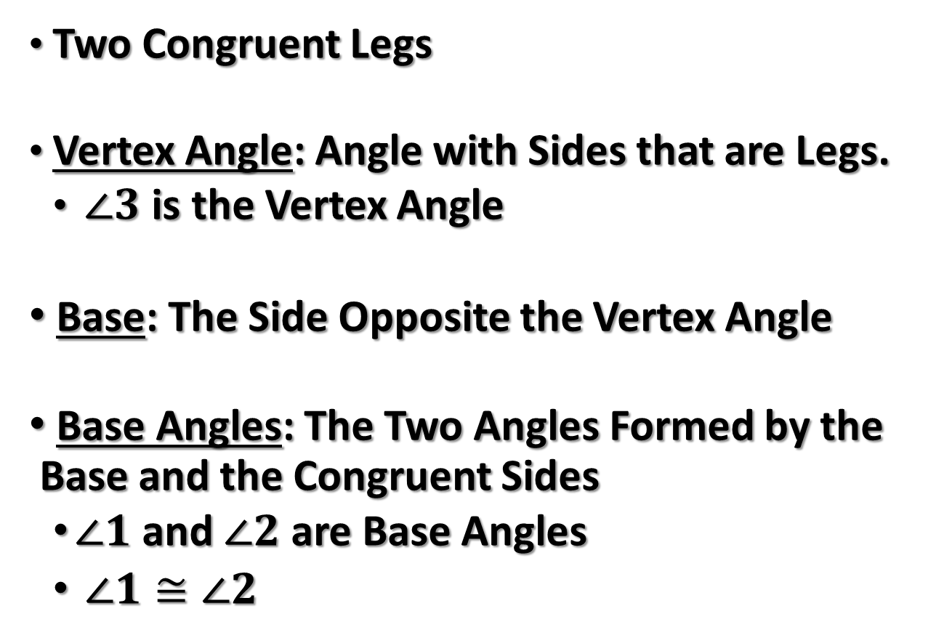


Isosceles Triangles
Two Congruent Legs
Vertex Angle: Angle with Sides that are Legs.
  $∠3$ is the Vertex Angle
Base: The Side Opposite the Vertex Angle
Base Angles: The Two Angles Formed by the Base and the Congruent Sides
  $∠1$ and $∠2$ are Base Angles
  $∠1≅∠2$
Vertex Angle
$$3$$
Leg
Leg
$$1$$
$$2$$
Base

Slide 3
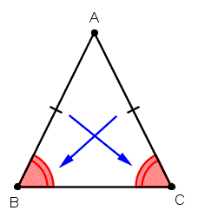
Isosceles Triangle Theorem: If two sides of a triangle are congruent, then the angles opposite those sides are congruent.

Slide 4
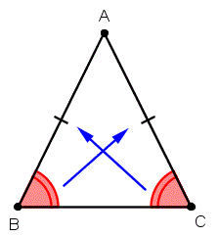
Converse of Isosceles Triangle Theorem: If two angles of a triangle are congruent, then the sides opposite the angles are congruent.

Slide 5







Example 1:
Find $m∠Y.$
$$X$$
$$38°$$
$$7$$
$$7$$
$$Z$$
$$Y$$

Slide 6






Example 2:
Find $m∠M$ and $PN$.
$$N$$
$$120°$$
$$12$$
$$M$$
$$P$$

Slide 7





Example 3:
Find x and y$.$
$$80°$$
$$4y−2$$
$$2y+2$$
$$6x+8$$

Slide 8

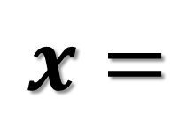











Example 4:
Find the missing sides and angles.
$$TS=10$$
$$T$$
$$WS=$$
$$57°$$
$$RT=$$
$$U$$
$$W$$
$$x=$$
$$5$$
$$x$$
$$R$$
$$S$$
$$V$$

Slide 9
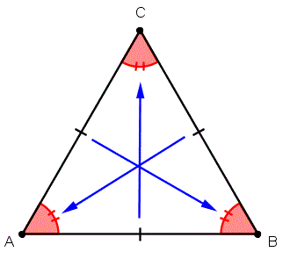
Corollary: A Statement that Follows Immediately from a Theorem
Corollary 4-3: A triangle is equilateral if and only if it is equiangular.
Corollary 4-4: Each angle of an equilateral triangle measures 60.

Slide 10





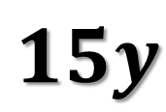
Example 5:
Find $x$, $y$, $z$, and $a$.
$$5x$$
$$3$$
$$4y−5$$
$$15y$$
$$6z$$

